Slide 1
Be-ATTITUDES
8 STATEMENTS OF FAITH FOR A CHRISTIAN

Slide 2
Matthew 5:1-12
Seeing the crowds, he went up on the mountain, and when he sat down his disciples came to him. And he opened his mouth and taught them, saying:
"Blessed are the poor in spirit, for theirs is the kingdom of heaven. "Blessed are those who mourn, for they shall be comforted "Blessed are the meek, for they shall inherit the earth. "Blessed are those who hunger and thirst for righteousness, for they shall be satisfied. "Blessed are the merciful, for they shall obtain mercy. "Blessed are the pure in heart, for they shall see God. "Blessed are the peacemakers, for they shall be called sons of God.
"Blessed are those who are persecuted for righteousness' sake, for theirs is the kingdom of heaven.
"Blessed are you when men reviled you and persecute you and utter all kinds of evil against you falsely on my account. Rejoice and be glad, for your reward is great in heaven, for so men persecuted the prophets who were before you."

Slide 3
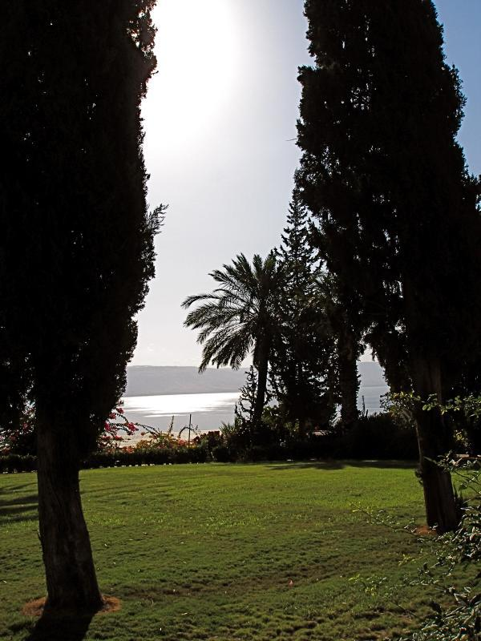

Slide 4
Beatitudes
Comes from the latin word, “beatus”
Greek, “makarios”, Hebrew “asher”
Fortunate, enviable state, joy, hope, deepest form of happiness
Independent of outward circumstances
Not one English word is sufficient
Happiness has the root word hap, meaning Chance.

Slide 5
The Beatitudes
What they are not | What they are
Not an extension of the Law | Strong meat for mature Christians
A code of ethics, rules | A celebration of true Christian life
An improvement of previous life | An invitation to a radical change of ATTITUDES
Live like this, and you will be a Christian | Because you are a Christian, live like this
Threats, terrors | Friendly, joyful
Menu | “served” whole
For some different type of Christians | For all Christians

Slide 6
ABCDEFGH
5:3 Blessed are the poor in spirit, for theirs is the Kingdom of heaven
5:4 Blessed are those who mourn, for they shall be comforted
5:5 Blessed are the meek, for they shall inherit the earth
5:6 Blessed are those who hunger and thirst for righteousness
5:7 Blessed are the merciful, for they shall be shown mercy
5:8 Blessed are the pure in heart , for they shall see God
5:9 Blessed are the peacemakers,.. children of God
5:10 Blessed are the persecuted ,. Kingdom of heaven
HGFEDCBA
5:13-20 You are the salt, light of the earth
5:21-26 First go and get reconciled
5:38-42 Turn the other cheek
5:43-48 Bless your enemies and pray for them
6:1-18 When you do good, do it in secret
6:25-34 Seek first the Kingdom/Gods righteousness
7:1-6 ….First remove the log in your eye…..
7:7-11 Ask, Seek, Knock to receive, find and get the door opened

Slide 7
Beatitude | Explanation within the Sermon
Matthew 5:3 Poor in spirit | Matthew 7:7-11 “Ask, Seek, Knock…”
Matthew 5:4 Mourn | Matthew 7:1-6 “ Log in your eye”
Matthew 5:5 Meek | Matthew 6: 25-34 “Seek first the Kingdom”
Matthew 5:6 Hunger/Thirst for God | Matthew 6:1-18 “Do good in secret”
Matthew 5:7 Merciful | Matthew 5:43-48 ‘’Bless your enemies”
Matthew 5:8 Pure in Heart | Matthew 5:38-42 “Turn the other cheek”
Matthew 5:9 Peacemakers | Matthew 5:21-26 “First go get reconciled”
Matthew 5:10 Persecuted | Matthew 5:13-20 “You are salt, light”
Chiasmic Style
ABCDEFGH HGFEDCBA

Slide 8
Be-ATTITUDE #2 Blessedness of Mourning
The Word for Mourning here (pentheo) is the strongest in the greek language.
Bewail, Lament, mourn for, like for a dearly loved person
(Gen 37:34 (Septuagint) Jacobs grief when he thought Joseph was dead )

Slide 9
Mourning for what?
One’s bitter experience with life?
Sad circumstances in the world: disease, war, Al Shabab?
One’s Sin?
Makarios are those who are led to pentheo because they deplore the effect of sin in their lives, they therefore yearn for and seek (and find) the deliverance of Christ
i.e Not all mourners are comforted

Slide 10
Matthew 7:1-6
"Judge not, that you be not judged. For with the judgment you pronounce you will be judged, and with the measure you use it will be measured to you. Why do you see the speck that is in your brother's eye, but do not notice the log that is in your own eye? Or how can you say to your brother, 'Let me take the speck out of your eye,' when there is the log in your own eye? You hypocrite, first take the log out of your own eye, and then you will see clearly to take the speck out of your brother's eye

Slide 11
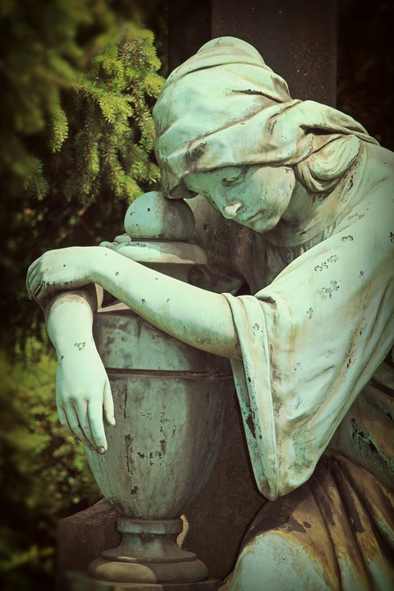
Blessed are the poor in spirit who mourn. Blessed are the people who feel keenly their inadequacies and their guilt and their failures and their helplessness and their unworthiness and their emptiness—who don't try to hide these things under a cloak of self-sufficiency, but who are honest about them and grieved and driven to the grace of God.

Slide 12
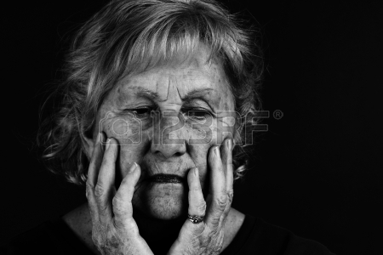
Mat 4:17 From that time Jesus began to preach, saying, "Repent, for the kingdom of heaven is at hand.“
Jesus’ message was really about repentance.
2Co 7:10 For godly grief produces a repentance that leads to salvation without regret, whereas worldly grief produces death.
(Grief: lupē sadness, heaviness, sorrow)
(Repentance: metanoia (subjectively) compunction (for guilt, including reformation); by implication reversal (of decision).
And we cannot repent without Godly Sorrow

Slide 13
Mourners “Gosh! What have I done?” | Non mourners “Mh, It’s a small matter”
David: Psalm 51: 1- | Saul: 1Samuel 15: 9-20
Jesus: Isaiah 53:3-4 | Nebuchadnezzar
Paul : Romans 7: 24 | etc
Josiah: 2kings 22: 19
The King of Nineveh: Jonah 3:6

Slide 14
Psalm 51:1-4
Have mercy on me, O God, according to your steadfast love; according to your abundant mercy blot out my transgressions. Wash me thoroughly from my iniquity, and cleanse me from my sin! For I know my transgressions, and my sin is ever before me. Against you, you only, have I sinned and done what is evil in your sight, so that you may be justified in your words and blameless in your judgment.
Result:
vs 8 Let me hear joy and gladness; let the bones that you have broken rejoice.
Vs 13Then I will teach transgressors your ways, and sinners will return to you.

Slide 15
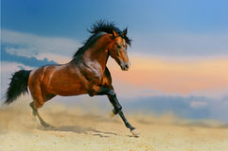
Be-ATTITUDE #3 Blessedness of meekness?
Meek (greek praus) does not mean weakness, cowardice, spiritless
It was used (350 years ago) of horses and other wild animals whose naturally wild spirits were broken by a trainer so that they can do useful work
Gentle of spirit, submissive, tender-hearted
Three times in the synoptic gospels:
Matthew 5:5
Matthew 11:28-Invitation to us
Matthew 21:5- Meek King on a meek animal on conquest (Zech 9:9)

Slide 16
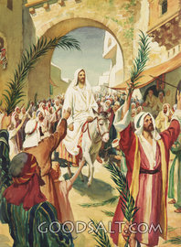
Zechariah 9:9
Rejoice, O people of Zion! Shout in triumph, O people of Jerusalem! Look, your king is coming to you. He is righteous and victorious, yet he is meek, riding on a donkey--riding on a donkey's colt.
Cf. Maccabbeus

Slide 17
164 BC Antiochus IV Epiphanes a terrible ruler: a massive tax on Jerusalem, naked Greek games, sacrificed a pig in the holy of holies (abomination that causes desolation), killed as many as 40,000 Jews in one day
Judas Maccabees or “Judah the Hammer” led an overthrow of Antiochus (Hannukah).
He rode into Jerusalem (on a horse) after his victory greeted by palm-waving citizens (1 Mac. 13:51)
He went to the Temple and cleansed it. He was crowned king in Jerusalem
“Pay back the Gentiles in full, and heed what the law commands.” – 1 Maccabees 2:68
An exhortation to Judah the Hammer and became something of a famous saying in Jerusalem by the time of Jesus
Judah’s son killed 800 Jews who protested against their rule.

Slide 18
"Blessed are the meek, for they shall inherit the earth”.
MEEK-humble .This beatitude may have looked ridiculous to the jews who expected a messiah to be a King who would lead them to victory over the hated Romans
Expectation: militaristic Kingdom, massive army
Meek and gentle messiah—an absurdity to zealous jews
They did not recognize the Suffering Servant of Isaiah as the Messiah
A person who chooses to be Meek and gentle person - also an absurdity in our world

Slide 19
They are the meek, who are rarely and hardly provoked, but quickly and easily pacified, who would rather forgive 20 injuries than revenge one, having the rule of their spirits.
Henry

Slide 20
Meaning of meekness
"Therefore I tell you, do not be anxious about your life, what you will eat or what you will drink, nor about your body, what you will put on. Is not life more than food, and the body more than clothing? Look at the birds of the air: they neither sow nor reap nor gather into barns, and yet your heavenly Father feeds them. Are you not of more value than they? And which of you by being anxious can add a single hour to his span of life?......But seek first the kingdom of God and his righteousness, and all these things will be added to you”.
Matthew 6:25-
But I have calmed and quieted my soul, like a weaned child with its mother; like a weaned child is my soul within me.
Psalm 131: 2

Slide 21
What Does Meekness Have to Do with God?
Trust in the LORD, and do good; dwell in the land and befriend faithfulness.
Delight yourself in the LORD, and he will give you the desires of your heart.
Commit your way to the LORD; trust in him, and he will act.
He will bring forth your righteousness as the light, and your justice (right) as the noonday.
Be still before the LORD and wait patiently for him; fret not yourself over the one who prospers in his way, over the man who carries out evil devices!
But the meek shall inherit the land and live in abundant peace
Psalm 37: 3-7, 11(ESV)

Slide 22
What are the meek like???
Verse 5 they commit their way to the Lord and trust in the Lord.
They admit that they are insufficient to cope with the complexities and pressures and obstacles of life, and they trust that God is able and willing to sustain them and guide them and protect them.
Verse 7 says they are quiet or still before the Lord and do not fret over others who prosper.
They discover that God can be trusted. They wait patiently in stillness for His work in their lives
Verse 8 they refrain from anger and forsake wrath.
They wait to see how His power and goodness will work things out; and so the setbacks and obstacles and opponents of life do not produce the kind of bitterness and anger and fretfulness that is so common among men.
Verse 9, wait for the Lord?

Slide 23
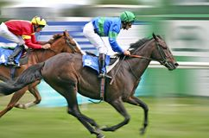
An inner masterly, equilibrium
The meek are not simply submissive because they lack the resources for anything else
Meekness is compatible with great strength
The strong who decline to domineer

Slide 24
Moses
Numbers 12:1-10
Miriam and Aaron spoke against Moses because of the Cushite woman whom he had married, for he had married a Cushite woman; and they said, "Has the Lord indeed spoken only through Moses? Has he not spoken through us also?" And the Lord heard it. Now the man Moses was very meek, more than all men that were on the face of the earth. And suddenly the Lord said to Moses and to Aaron and Miriam, "Come out, you three, to the tent of meeting."
How was Moses’ meekness evident?
How was it rewarded?

Slide 25
The Meekness of Wisdom
"Who is wise and understanding among you? By his good life let him show his works in the meekness of wisdom.“ (James 3:13)
The truly wise people are also the truly meek people. Why?
verse 17: "But the wisdom from above is first pure, then peaceable, gentle, open to reason . . . “
Isn't it remarkable that meekness and wisdom described in the same way?
They are both peaceable, gentle, and open to reason.

Slide 26
The price of meekness
³⁸ “You have heard that it was said, ‘eye for eye, and tooth for tooth.’^{[a]} ³⁹ But I tell you, do not resist an evil person. If anyone slaps you on the right cheek, turn to them the other cheek also. ⁴⁰ And if anyone wants to sue you and take your shirt, hand over your coat as well.
Matthew 5:38-

Slide 27
Full Portrait of Meekness
Meekness begins when we put our trust in God.
Then we commit (Heb: galal =roll) our way to Him. We “roll” onto Him our anxieties, frustrations, plans, relationships, jobs, health etc
We wait patiently for the Lord
We trust His timing and His power and his grace to work things out in the best way for His Glory and for our good.
Meekness begins with God and ends with God

Slide 28
The reward of meekness
…..Shall inherit the earth
Oil wells, orchards, fancy cars???
The meek shall be received in His Kingdom
Partake all its blessings—best possible life on earth
And the glories of the heavenly Canaan hereafter

